Slide 1
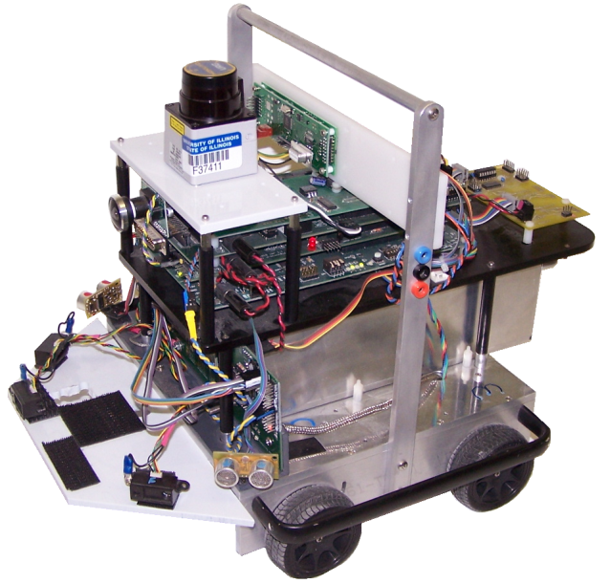
Robust Localization Kalman Filter

Slide 2
State Space Representation
Continuous State Space Model
$$x=\left[\begin{matrix}\begin{matrix}θ_{1} \\ {\dot{θ}}_{1}\end{matrix} \\ \begin{matrix}θ_{2} \\ {\dot{θ}}_{2}\end{matrix}\end{matrix}\right], \dot{\dot{x}=\left[\begin{matrix}\begin{matrix}\dot{θ_{1}} \\ \ddot{θ_{1}}\end{matrix} \\ \begin{matrix}\dot{θ_{2}} \\ \ddot{θ_{2}}\end{matrix}\end{matrix}\right]=\left[\begin{matrix}\begin{matrix}0 & 1 \\ C1 & C2\end{matrix} & \begin{matrix}0 & 0 \\ C3 & C4\end{matrix} \\ \begin{matrix}0 & 0 \\ C5 & C6\end{matrix} & \begin{matrix}0 & 1 \\ C7 & C8\end{matrix}\end{matrix}\right]x+\left[\begin{matrix}\begin{matrix}0 & 0 \\ C9 & 0\end{matrix} \\ \begin{matrix}0 & 0 \\ 0 & C10\end{matrix}\end{matrix}\right]\left[\begin{matrix}u_{1} \\ u_{2}\end{matrix}\right]}$$
$$\left[\begin{matrix}y_{1} \\ y_{2}\end{matrix}\right]=\left[\begin{matrix}\begin{matrix}1 & 0 \\ 0 & 0\end{matrix} & \begin{matrix}0 & 0 \\ 1 & 0\end{matrix}\end{matrix}\right]x$$
Commonly written $\dot{x}=Ax+Bu$
$y=Cx$
Discrete State Space Model
$$x_{k+1}=\left[\begin{matrix}\begin{matrix}{θ1}_{k+1} \\ {\dot{θ1}}_{k+1}\end{matrix} \\ \begin{matrix}{θ2}_{k+1} \\ {\dot{θ}2}_{k+1}\end{matrix}\end{matrix}\right]\dot{=\left[\begin{matrix}\begin{matrix}D1 & D2 \\ D5 & D6\end{matrix} & \begin{matrix}D3 & D4 \\ D7 & D8\end{matrix} \\ \begin{matrix}D9 & D10 \\ D13 & D14\end{matrix} & \begin{matrix}D11 & D12 \\ D15 & D16\end{matrix}\end{matrix}\right]x_{k}+\left[\begin{matrix}\begin{matrix}D17 & D18 \\ D19 & D20\end{matrix} \\ \begin{matrix}D21 & D22 \\ D23 & D24\end{matrix}\end{matrix}\right]\left[\begin{matrix}{u1}_{k} \\ {u2}_{k}\end{matrix}\right]}$$
$$\left[\begin{matrix}{y1}_{k} \\ {y2}_{k}\end{matrix}\right]=\left[\begin{matrix}\begin{matrix}1 & 0 \\ 0 & 0\end{matrix} & \begin{matrix}0 & 0 \\ 1 & 0\end{matrix}\end{matrix}\right]x_{k}$$
Commonly written $x_{k+1}=Fx_{k}+Gu_{k}$
$y_{k}=Hx_{k}$

Slide 3
Discrete State Space Observer or Estimator
$$\hat{x_{k+1}}=F\hat{x_{k}}+Gu_{k}+L\left(y_{k}−\hat{y_{k}}\right)$$
$$\hat{y_{k}}=H\hat{x_{k}}$$
Find L to meet your Design Needs
If system is Observable, poles of F-LH can be placed anywhere*.
*Very fast poles amplify noise issues

Slide 4
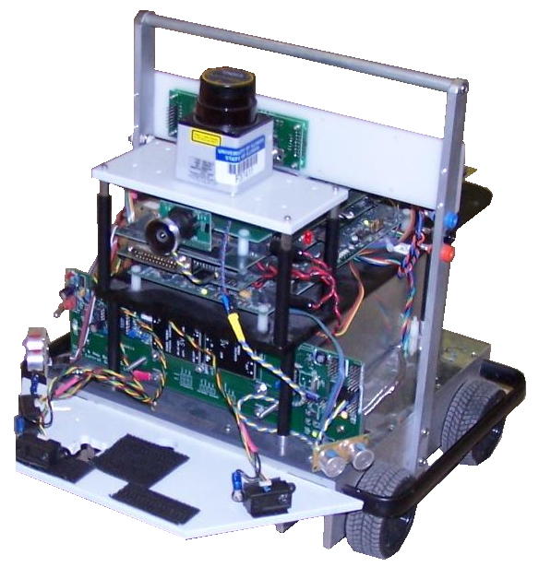
Overview
System model
Problem statement
Sensor model
State estimator
Code

Slide 5
A 1-Dimensional Sensor Fusion Problem
Given two measurements of the same state x, find the “best” value to assign to x and a measure of confidence in that new x value.
Use Normal distributions to define our measurements and “best” estimate of our states. N(mean, variance). The mean is the value for state x and variance is our trust in this value where smaller variance indicates larger trust.

Slide 6
1-D Example
For this simple example, using our robot, let’s assume that we apply the same control effort to both motors and in doing so the robot travels in a straight line. We then can form a kinematic State Space model of the distance the robot is away from the front wall:
$$x_{k+1}=x_{k}−v_{k}∆t+q_{k}$$
x is the robot’s distance from the wall, v is the robot’s velocity and q is the system uncertainty or noise. After driving the robot many times up to this front wall and collecting and analyzing the data, you find that the variance of the state estimation is 0.5. Doing a similar run of tests using the ultrasonic sensor and the LADAR you find that the variance of the ultrasonic distance measurement is 1.0 and the variance of the LADAR measurement is 0.1. Then picking one point in time of the robot’s travel to the front wall you find that the model gives you a reading of 2 and the ultrasonic sensor gives you a reading of 4 and the LADAR gives you a reading of 5.
With out knowing anything about Kalman filtering, how would you “fuse” this data at this point in time?

Slide 7
1-D Example
First “fuse” the model’s prediction with the Ultrasonic data and come up with a new “best” distance and value of trust.
Second “fuse” the new “best” distance and value of trust with the LADAR data.
Since we trust the system model twice as much as the Ultrasonic measurement how could we combine the two?

Slide 8
1-D Example
$$xbest= \frac{x_{model}(1/{{var}_{model}})+x_{us}(1/{{var}_{us}})}{1/{{var}_{model}}+1/{{var}_{us}}}$$
$varbest={var}_{model}({{var}_{us}}/{{(var}_{model}+{var}_{us})})$
Doing some algebra and organizing into a nice form:
$$xbest= x_{model}+K\left(x_{us}−x_{model}\right)$$
$$varbest=\left(1−K\right){var}_{model}$$
where $K= \frac{{var}_{model}}{{var}_{model}+{var}_{us}}$
Show ProbExample.m in Matlab

Slide 9
1-D Example in Kalman Filter Form
$${\hat{x}}_{k+1|k}= {\hat{x}}_{k|k}−∆tv_{k}$$
$${var}_{k+1|k}={var}_{k|k}+q_{k|k}$$
S = ${var}_{k+1|k}+{var}_{us}$
$$K=\frac{{var}_{k+1|k}}{S}$$
$${\hat{x}}_{k+1|k+1}= {\hat{x}}_{k+1|k}+K\left(x_{us}−{\hat{x}}_{k+1|k}\right)$$
$${var}_{k+1|k+1}=(1−K){var}_{k+1|k}$$
Prediction Step usually happens many more times and much faster then the Correction Step but does not have to.
Prediction Step
Correction Step
Innovation

Slide 10
System Model
Derivation of control inputs
Notes:
This talk won’t cover low level controller for vel and ang vel

Slide 11
System Evolution
State update equation:
Notes:
Unicycle model, bound noise with zero mean Gaussian

Slide 12
Objective
At all times, have a state estimate close to the true state
Minimize the current expected squared error

Slide 13
Dead Reckoning
Robot
Dead Reckoned Path
Notes:
Mention not waiting to try and perfect dead reckoning
The inaccuracy of a good-quality navigational system is normally fewer than 0.6 nautical miles per hour in position and on the order of tenths of a degree per hour in orientation.
A.D. King, “Inertial Navigation – 40 years of Evolution”

Slide 14
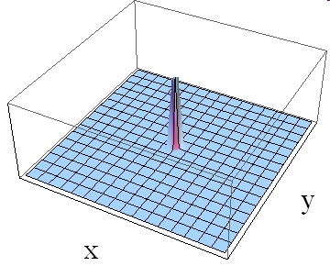
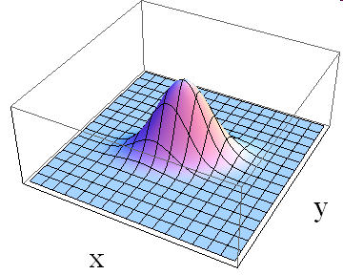
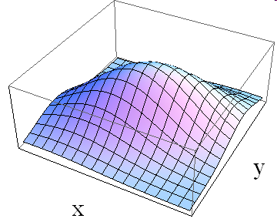
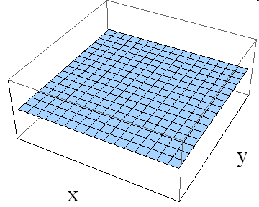
Expected Error
Notes:
He that leaves nothing to chance will do few things ill, but he will do very few things. Lord Halifax 1633-1695

Slide 15
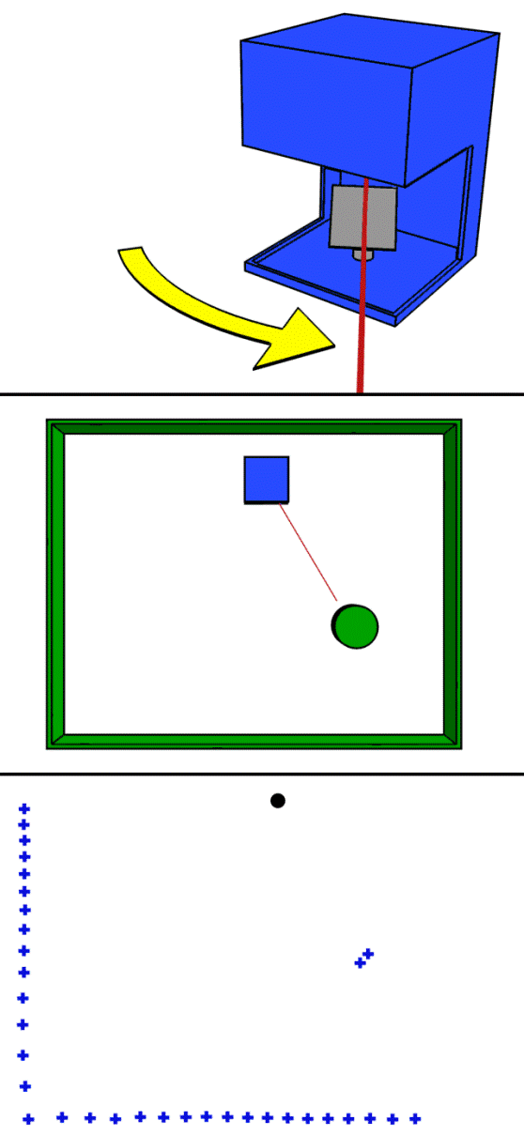
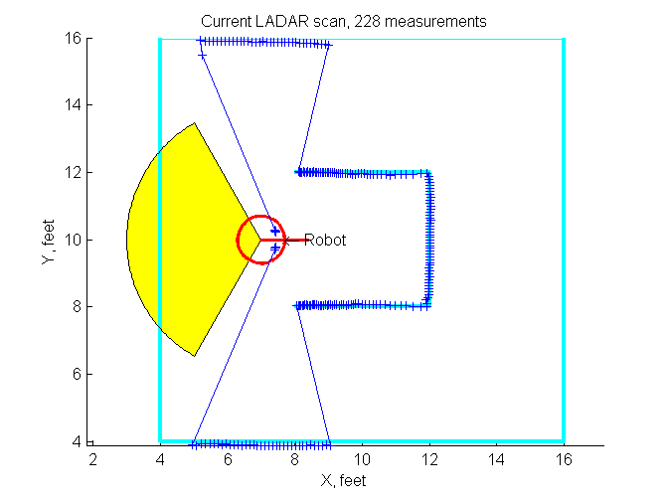
Sensor Model
http://en.wikipedia.org/wiki/LIDAR
Notes:
http://en.wikibooks.org/wiki/Communication_Systems/Wireless_Transmission
formula for the effective area of an ideal isotropic antenna into this equation, we get the following result:
Pt power transmitted
Lambda the wavelength
Ri the distance
Isotropic: radiates power equally in all directions

Slide 16
State Estimation – Observers Without Probability –
Often we have fewer sensors than states or sensors that do not return our state directly

Slide 17
Kalman Filter

Slide 18
Application Specific Kalman Filter

Slide 19
Kalman Filter Video
Dead Reckoned Path
Confidence Ellipse
Kalman Filtered Path
LADAR Measurements

Slide 20
Kalman Filter Blindfolding the Robot
Dead Reckoned Path
Confidence Ellipse
Kalman Filtered Path
LADAR Measurements

Slide 21
Code Review
Corner detection
Kalman filter

Slide 22
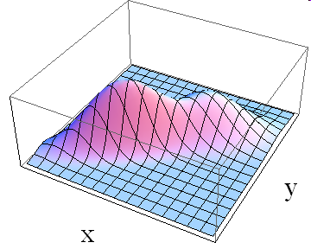
Extended Kalman Filter – Dealing With Nonlinearities
The Kalman filter is the optimal linear estimator
The robotic system is nonlinear
System can be linearized
We will still have the best linear estimator at the estimated operating point
EKF algorithm
Notes:
Disadvantages of the extended Kalman filter
Unlike its linear counterpart, the extended Kalman filter is not an optimal estimator. In addition, if the initial estimate of the state is wrong, or if the process is modeled incorrectly, the filter may quickly diverge, owing to its linearization. Another problem with the extended Kalman filter is that the estimated covariance matrix tends to underestimate the true covariance matrix and therefore risks becoming inconsistent in the statistical sense without the addition of "stabilising noise".
Having stated this, the extended Kalman filter can give reasonable performance, and is arguably the de facto standard in navigation systems and GPS.
Multiple Kalman filters result in exp. Explosion
Unscented require (2L+1) extra points where L is size of augmented state (add the expected mean and covariance of process noise to the state and covariance matrices (respectively) – captures the true mean and covariance.

